Slide 1
Iceberg Detection and Tracking
using Machine Learning
Sania Bandekar & Victoria Le
Notes:
BOTH introduce

Slide 2
Demo
Notes:
VICTORIA starts

Slide 3
Project Overview
Problem Statement: : Image classification for determining if an object in a photo is an iceberg or a ship
Goal: Build a machine learning model using CNN for identifying icebergs from satellite images
Notes:
The goal of this project is to classify images into two categories: iceberg and non-iceberg, based on satellite imagery. This problem is important for monitoring climate change and environmental conditions

Slide 4
Dataset Preparation
Data Sources:
Dataset source: JSON files
Features: band_1 (image data), is_iceberg (label)
Dimensions: 75x75 pixels per image
Preprocessing Steps:
Load and reshape images
Normalize pixel values
Train-test split (80/20)
Notes:
The dataset consists of JSON files containing image data (band_1) and corresponding labels (is_iceberg). Each image is a 75x75 pixel grayscale image, and the label indicates whether the image contains an iceberg or not. The images were reshaped and normalized

Slide 5
Data Loading
Datasets loaded from JSON files
Images
Stored as arrays within the band_1 key
Convert these arrays into NumPy arrays
Reshape them into 75x75 pixel arrays (input)
Notes:
we load the training and test datasets from JSON files. The images are stored as arrays within the band_1 key. We then convert these arrays into NumPy arrays and reshape them into 75x75 pixel arrays, which are the input for our model

Slide 6
Data Normalization
Normalization Process:
Rescaling pixel values between 0 and 1
Helps the model learn faster and improves convergence
Notes:
We normalized the images to scale the pixel values between 0 and 1. This step helps the model learn more efficiently and speeds up convergence during training.

Slide 7
Model Architecture Overview
Type of Model: Convolutional Neural Network (CNN).
Layers: 3 convolutional layers followed by dense layers.
Final Layer: Sigmoid activation for binary classification.
Notes:
We built a Convolutional Neural Network (CNN), which is great for image classification tasks. Our model includes three convolutional layers to extract features from images, followed by dense layers to make the final prediction

Slide 8
Convolutional Layers
First Layer: 32 filters, 3x3 kernel.
Second Layer: 64 filters, 3x3 kernel.
Third Layer: 128 filters, 3x3 kernel.
Padding: 'Same' to retain spatial dimensions.
Notes:
In the convolutional layers, we started with 32 filters, increasing to 128 filters in subsequent layers. This allows the model to capture both basic and complex features in the images. We used 'same' padding to ensure the output has the same spatial dimensions as the input.

Slide 9
Max Pooling Layers
Pooling Size: 2x2 to reduce dimensionality and retain key features.
Notes:
VICTORIA ENDS
Following each convolutional layer, we applied max pooling with a 2x2 window to reduce the dimensionality of the feature maps and focus on the most important features.
This reduces the amount of data passed to the subsequent layers, which decreases the computational load and also helps in preventing overfitting

Slide 10
Model Regularization
Dropout: 30% to prevent overfitting.
L2 Regularization: Penalize large weights.
Notes:
SANIA Starts
To prevent overfitting, we used dropout with a rate of 30%. Additionally, we applied L2 regularization to the convolutional and dense layers to penalize large weights and improve generalization

Slide 11
Dense Layers
First Dense Layer: 128 neurons with ReLU activation.
Second Dense Layer: Output layer with 1 unit, and sigmoid activation.
Notes:
We used a dense layer with 128 neurons, followed by a second dense layer with a single output unit. The final layer uses a sigmoid activation function, which is typically used for binary classification tasks like iceberg detection. The output will be a probability between 0 and 1, representing the model's confidence in the prediction.

Slide 12
Model Compilation
Optimizer: Adam (learning rate = 0.001).
Loss Function: Binary cross-entropy.
Metrics: Accuracy.
Notes:
We compiled the model using the Adam optimizer, which adjusts the learning rate during training. We used binary cross-entropy as the loss function, suitable for binary classification, and monitored accuracy as a metric

Slide 13
Model Training
Epochs: 50
Batch Size: 32
Validation Data: Validation loss and accuracy
Notes:
The model was trained for 50 epochs with a batch size of 32. After every 32 samples, the model updates its weights. Validation data was used to monitor the model’s performance, detect overfitting and adjust the learning rate when necessary

Slide 14
Learning Rate Adjustment
ReduceLROnPlateau: Reduce learning rate by 50% if validation loss stagnates.
Notes:
To improve training stability, we used the ReduceLROnPlateau callback to reduce the learning rate by 50% if the validation loss stopped improving for three consecutive epochs

Slide 15
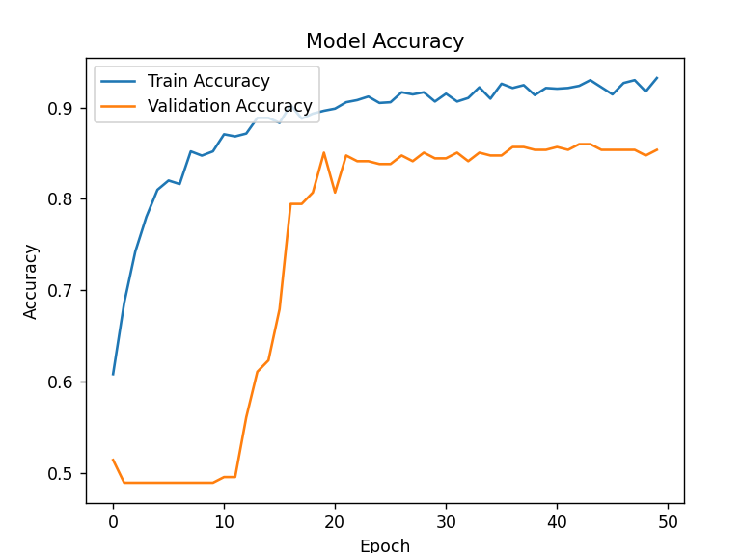
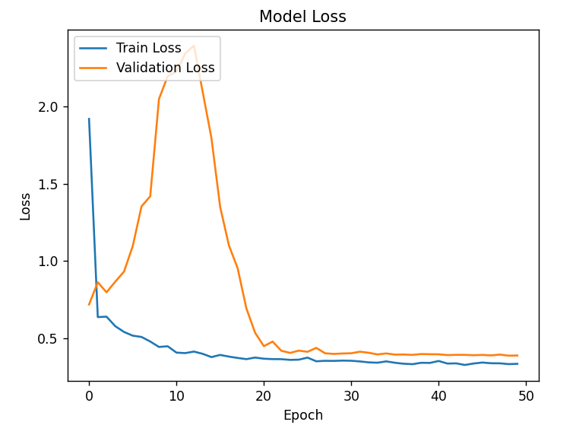
Training Results
Notes:
Here are the training and validation accuracy results. As you can see, the model performed well on both the training and validation datasets, showing it’s learning effectively. Model accuracy and loss is 0.93 and 0.21 which is slightly better since the project check in: 0.90 and 0.37

Slide 16
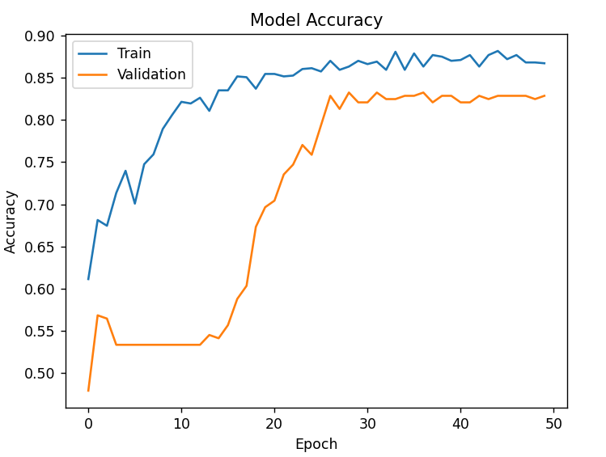
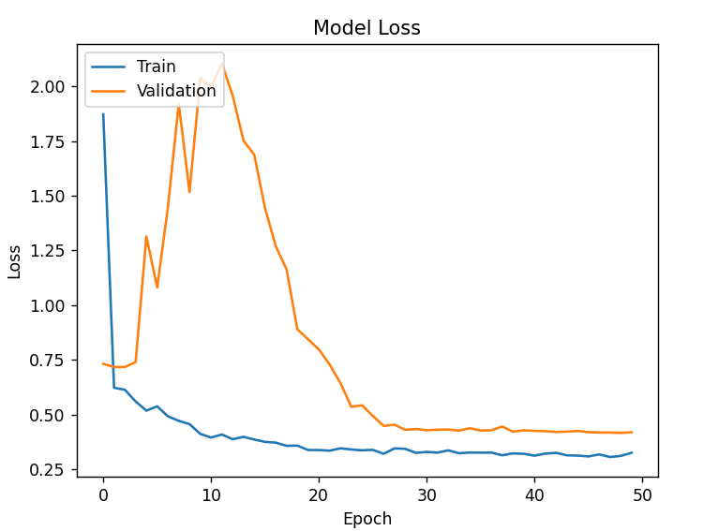
Training Results
Notes:
The accuracy seems to be similar but loss was 0.30 which is slightly better results since the project check in where loss was slightly under 0.5

Slide 17
Model Evaluation
Confusion Matrix: To evaluate classification results
Metrics: Accuracy and Loss
 | Predicted: Iceberg | Predicted: Non-iceberg
Actual: Iceberg | True Positive | False Negative
Actual: Non-iceberg | False Positive | True Negative
Notes:
True Positives (TP): The model correctly predicted an iceberg.
False Negatives (FN): The model predicted no iceberg, but there was one.
False Positives (FP): The model incorrectly predicted an iceberg, but there was none.
True Negatives (TN): The model correctly predicted no iceberg.
Accuracy measures the proportion of correct predictions (both true positives and true negatives) out of all predictions. A model with an accuracy of 93% means it correctly classified 93% of the test images as either iceberg or non-iceberg.
Loss represents how well the model's predictions match the true labels. A lower loss value indicates that the model is making fewer errors. In this case, the reduction in loss from 0.37 to 0.21 suggests that the model has learned more effectively and is making more accurate predictions over time.

Slide 18
Challenges Encountered
Prediction always said it is a ship
Could not find 75*75 pixel sized image

Slide 19
Questions

